Slide 1
SLEEPING TEACHING ASSISTANT
GROUP III
Solleti Krishna Chaitanya Subhash(AP20110010232)
Kumar Sashank Ganta(AP20110010229)
Geetha Sri Abhinay Parimisetty(AP20110010221)

Slide 2
ABSTRACT
TA provides assistance to a student during office hours.
If a chair is empty, a student may occupy it and wait
If all ‘n’ chairs are occupied, the student can come back later.
When there is no student, TA takes a nap.
The student may wake up the TA asking for assistance.
Output Data
A welcome screen with the animated name of our project including options to enter by the user.

Slide 3
Software Requirements….
The software requirements are:
Operating systems : Windows 7
Software : VS code , Ecilispe
Personal Computer : 350 MHz

Slide 4
Hardware Requirements….
The Hardware Requirements are :
Processor : Windows i3 4thGen
Random Access Memory :100MB
Disc : 30MB for installation and 64MB for cache.

Slide 5
SOLUTION APPROACH
Each student - A Process
Teaching Assistant’s Room – Critical Section
The processes needs to be synchronized

Slide 6
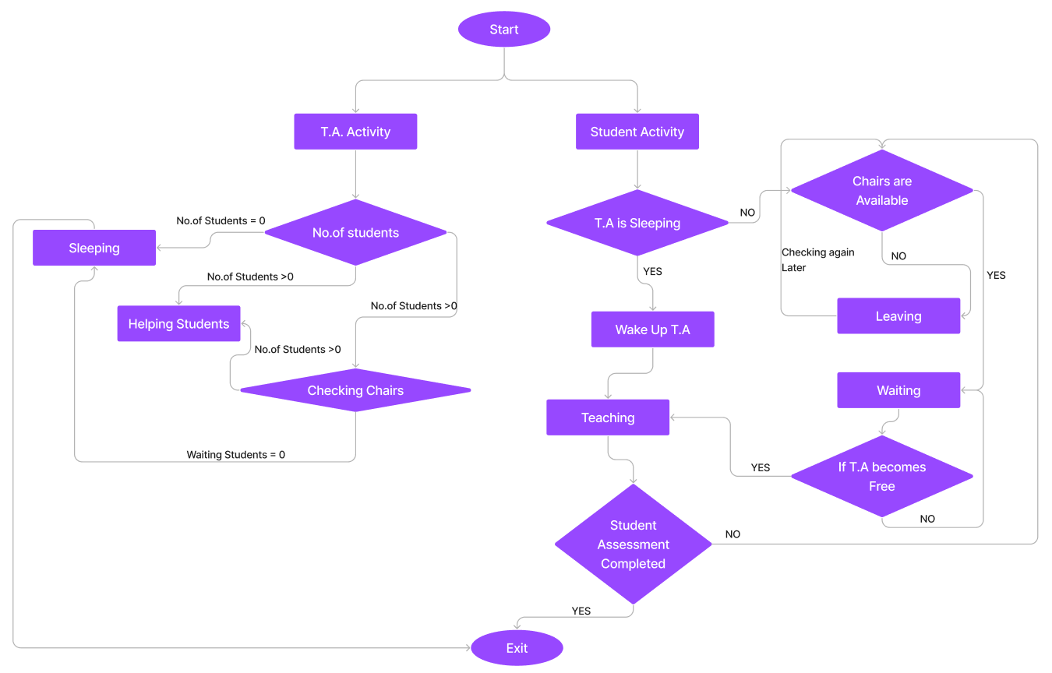
Flowchart:

Slide 7
PROCESS SYNCHRONIZATION
Processes running simultaneously may try to access the same shared data or resource at the same time
Co-operating Process : Process that can affect execution of another process
Race Condition: Several processes access and manipulate the same data concurrently.
Process Synchronization is done to avoid inconsistency of data.
It ensures that no two processes can access the same shared resource or data simultaneously.

Slide 8
CRITICAL SECTION
Section of code consisting of shared resources that needs to be accessed by the process.
Critical Section Problem: To design a protocol such that -
Only one process can be executed inside the critical section at a time.
Other processes have to wait until the current process finishes executing in the critical section.

Slide 9
SOLUTIONS TO CRITICAL SECTION PROBLEM
The solution to critical section problem must satisfy three requirements
Mutual Exclusion
Progress
Bounded Waiting
There are three solutions to the critical section problem:
Hardware based solution-
Test and Set Lock
Software based solution-
Peterson’s solution
Semaphore

Slide 10
TEST AND SET LOCK
Uses a test and set instruction to provide synchronization.
Test and Set Instruction :
Instruction that returns the old value of a memory location.
Sets the memory location value to 1 as a single atomic.
Processes share a variable ‘lock’.
Ensures Mutual Exclusion and Progress, not Bound Waiting.

Slide 11
PETERSON’S SOLUTION
Software based solution to Critical Section Problem.
Works on only two processes where one process waits till the other gets out of the critical section.
Algorithm uses two variables - an array ‘flag’ and turn.
Satisfies the three essential criteria to solve the critical-section problem.
Since our problem requires minimum of three processes, this solution is not viable

Slide 12
SEMAPHORE
Synchronization tool represented as ‘S’.
An integer value shared between thread to manage the resources accessed by various processes.
Value of semaphore indicates whether a resource is available or not.
Has two versions
Binary
Counting

Slide 13
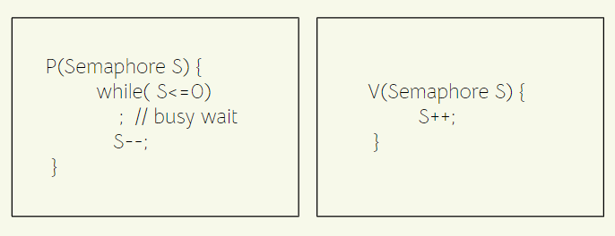
SEMAPHORE IMPLEMENTATION
Value of semaphore can be modified only through two operations :
wait() - Present in entry section of resources
signal() - Present in exit section of resources.

Slide 14
IMPLEMENTATION OF SLEEPING TEACHING ASSISTANT
Solution was implemented using semaphores and threads.
Two semaphores was used to capture two events.
TA is taking a nap, and a student approaches seeking assistance.
TA signals student waiting for assistance.
When TA is assisting a student, the other students are blocked.
Preference is given to the student who has waited for the maximum time.
When all chairs are occupied, students should start programming till the TA becomes free.
When there are no student to assist, the TA takes a nap.

Slide 15
Sample Input &
Output:
Source Code:
https://drive.google.com/drive/folders/1skPRmtztUwqldiLCl99grGCGj0Y_gtIX?usp=sharing

Slide 16
Conclusion
The Sleeping Teaching Problem is viewed as a Critical Section Problem.
Each student represented a process, the TA’s room the critical section.
Three solutions, Test and Set Lock, Peterson’s Solution,and Semaphore was explored.
Semaphore was found to be the best among the three, since
It is Machine Independent
It is follows Mutual Exclusion
Can handle multiple number of processes simultaneously

